Slide 1
SESUG 230-2019 Exploring Efficiency in Data Manipulation with SAS: How to Get the Most Out of My Software and Hardware
Jonathan W. Duggins
North Carolina State University
https://duggins.wordpress.ncsu.edu/

Slide 2
Presenter
Speaker Bio → Introduction → Efficiency Overview → Methods Overview → Graphical Results → Conclusions
Jonathan W. Duggins
Assistant Teaching Professor
Jonathan Duggins is an author of Fundamentals of Programming in SAS and an award-winning Teaching Professor at North Carolina State University, where his teaching includes multiple undergraduate and graduate programming courses. In addition to his academic work, he has worked as a biostatistician for multiple CROs. He has been a SAS user since 1999 and has presented at both regional and national statistical and SAS user group conferences.

Slide 3
Introduction
Speaker Bio → Introduction → Efficiency Overview → Methods Overview → Graphical Results → Conclusions
Selected efficiency settings overview
Methodology overview
Graphical investigation of results
Conclusions

Slide 4
Efficiency
Speaker Bio → Introduction → Efficiency Overview → Methods Overview → Graphical Results → Conclusions
Coding vs Computational
Usage Frequency
Efficiency vs Life-Cycle Planning
Usability
Modularity
Extensibility
Maintainability

Slide 5
Computational Efficiency Considerations
Speaker Bio → Introduction → Efficiency Overview → Methods Overview → Graphical Results → Conclusions
Join Techniques (one-to-one and one-to-many)
DATA step MERGE
With and without sorting (SORT) and indexing (DATASETS)
DATA step hash join
SQL join
With and without indexing (DATASETS)

Slide 6
Computational Efficiency Considerations
Speaker Bio → Introduction → Efficiency Overview → Methods Overview → Graphical Results → Conclusions
Option Name | Description | Availability
BUFNO | Specifies the number of buffers for processing SAS data sets.
BUFSIZE | Specifies the size of a buffer page for output SAS data sets.
COMPRESS | Specifies the type of compression to use for observations in output SAS data sets.
MEMSIZE | Specifies the limit on the amount of virtual memory that can be used during a SAS session. | Invocation only
REALMEMSIZE | Specifies the amount of real memory SAS can expect to allocate. | Invocation only
SORTSIZE | Specifies the amount of memory that is available to the SORT procedure.

Slide 7
Computational Efficiency Considerations
Speaker Bio → Introduction → Efficiency Overview → Methods Overview → Graphical Results → Conclusions
Data set properties
Typically not under user control for full data set
Several scenarios simulated based on:
Data set width (number of columns)
Data set length (number of records)
Variable type (character vs numeric)
Character values (long vs short)
Replication (fewer vs more during one-to-many merge)

Slide 8
Methods for Comparing Results
Speaker Bio → Introduction → Efficiency Overview → Methods Overview → Graphical Results → Conclusions
Many potential metrics
I/O usage, CPU time, Real time, Memory usage, etc.
FULLSTIMER global option
CPU time, Real time, Memory usage
Users have their own limitations
Real time is a constant resource concern though!
CPU time and Memory usage considered secondary metrics

Slide 9
Methods for Comparing Results
Speaker Bio → Introduction → Efficiency Overview → Methods Overview → Graphical Results → Conclusions
Background operations can have impacts
Multiple simulations run for each scenario
Total, mean, and median values investigated
Initial findings based on n=3 simulations
Relative rankings in findings unaffected by increase in replications or use of total/mean/median
Paper results shown here (n=3, Stat=Median)

Slide 10
Focus on What Matters: Hash, MERGE, or SQL?
Speaker Bio → Introduction → Efficiency Overview → Methods Overview → Graphical Results → Conclusions
Variable Sets
#3
Numeric: 16 variables
Character: 2 (length 16), 2 (32), 2 (64), 2 (128)
#4
Numeric: 16 variables
Character: 4 (16), 4 (32), 4 (64), 4 (128)

Slide 11
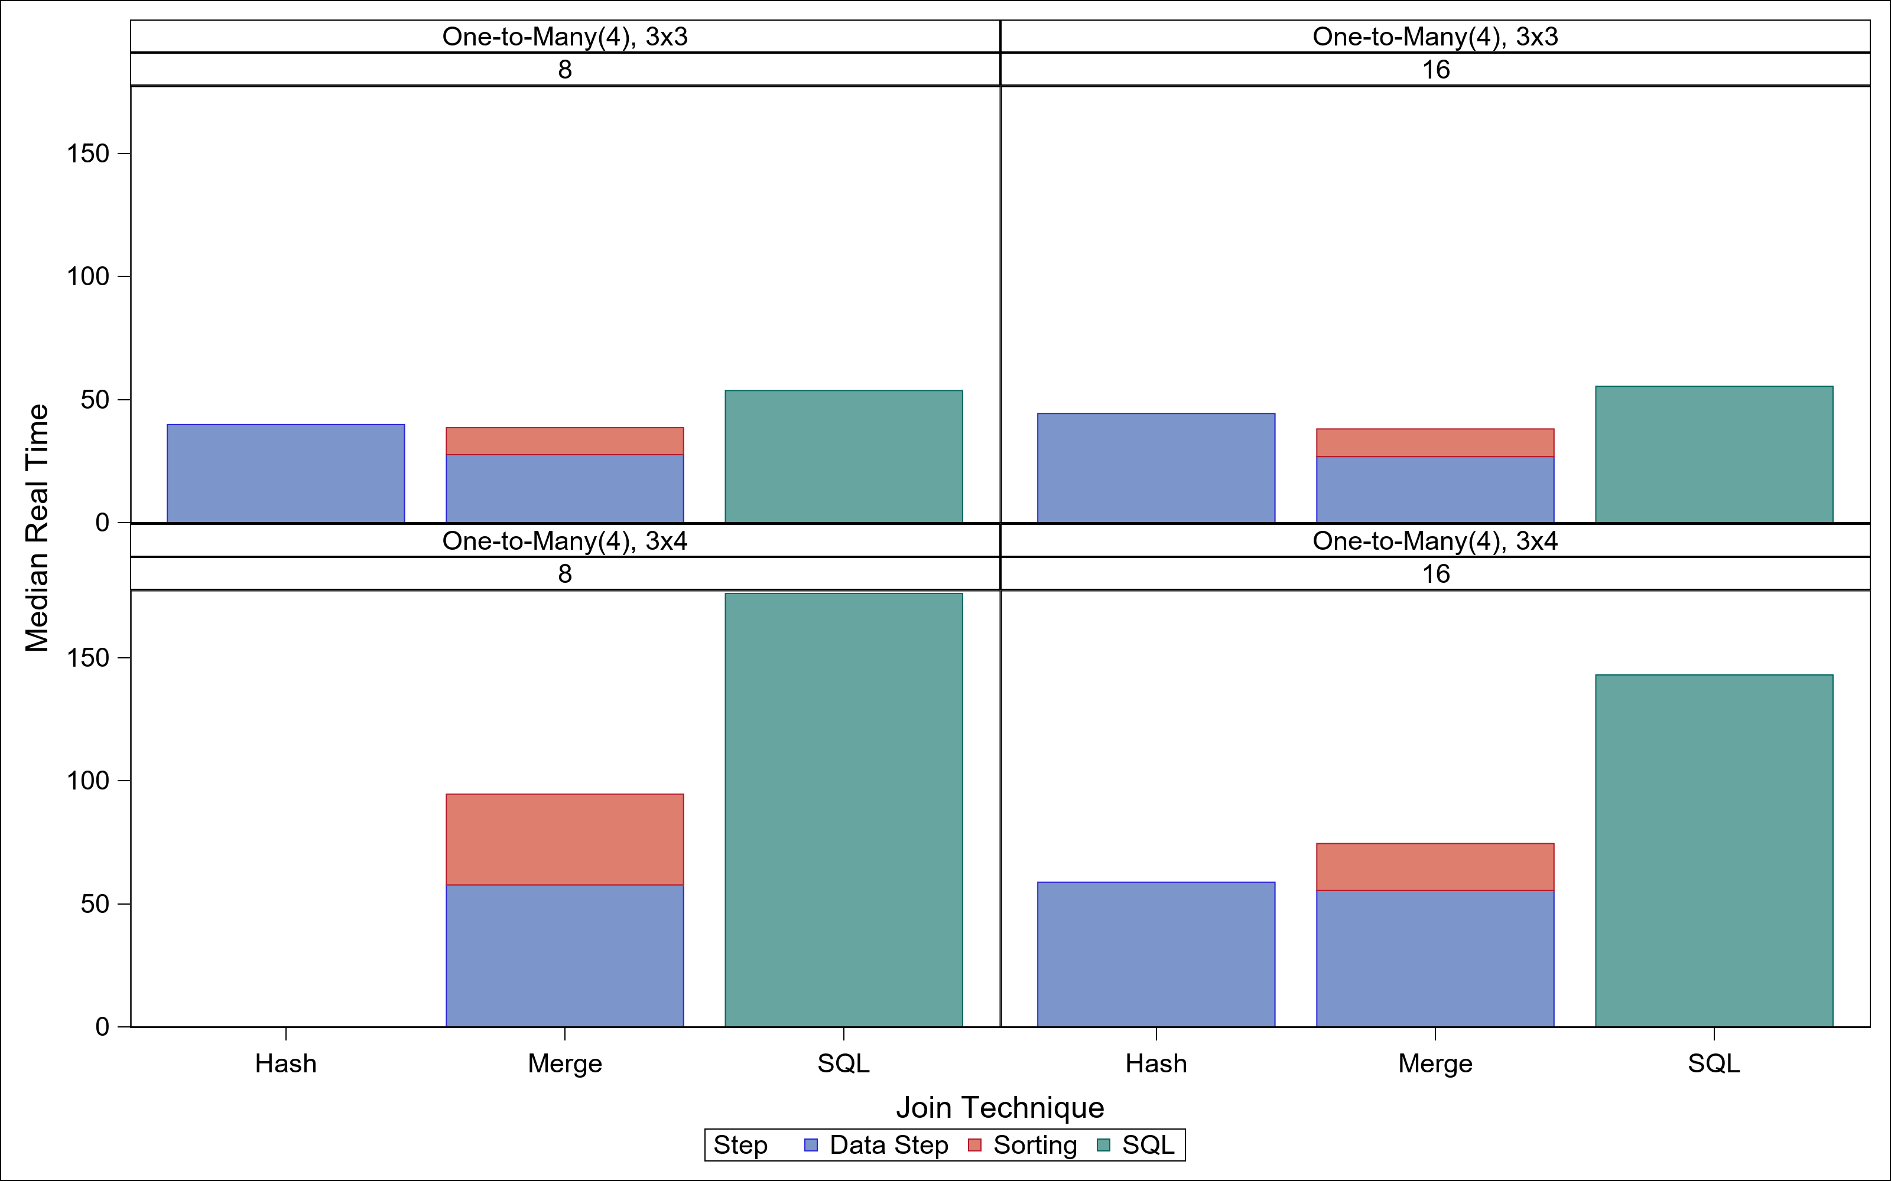
Speaker Bio → Introduction → Efficiency Overview → Methods Overview → Graphical Results → Conclusions

Slide 12
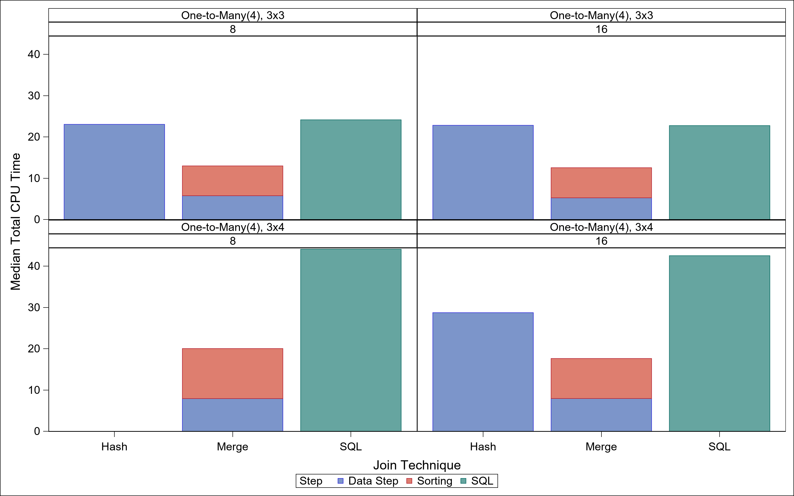
Speaker Bio → Introduction → Efficiency Overview → Methods Overview → Graphical Results → Conclusions

Slide 13
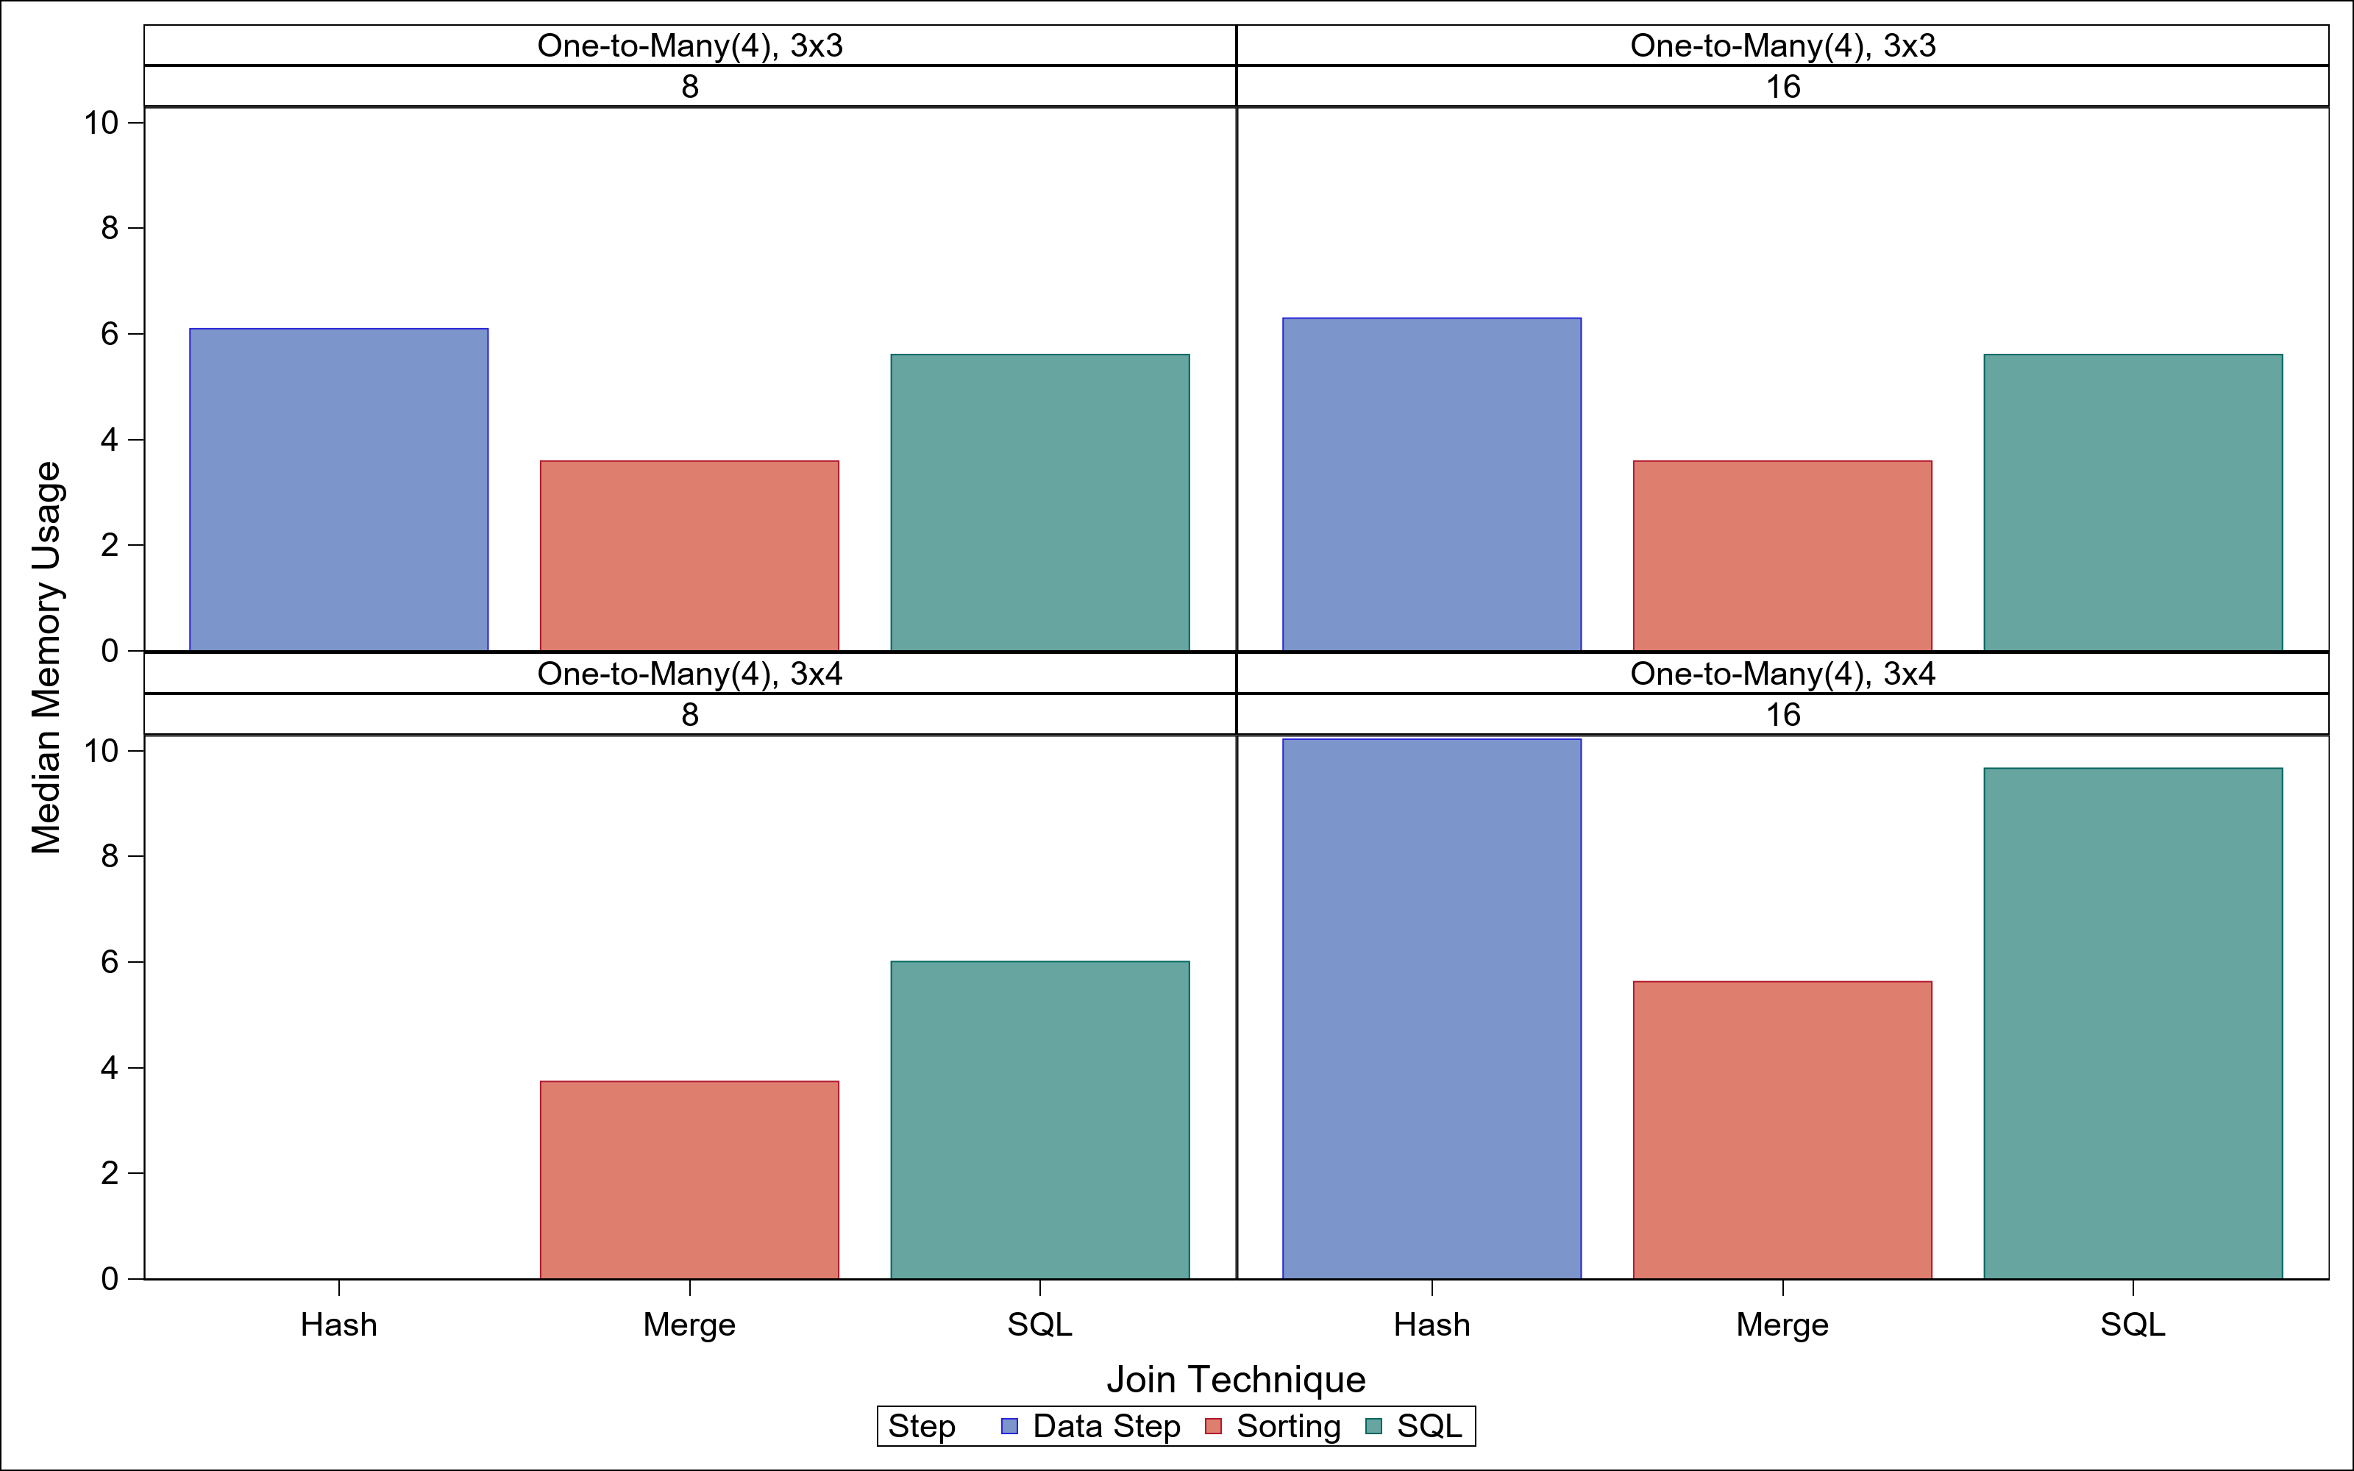
Speaker Bio → Introduction → Efficiency Overview → Methods Overview → Graphical Results → Conclusions

Slide 14
Aside: MEMSIZE and SORTSIZE
Speaker Bio → Introduction → Efficiency Overview → Methods Overview → Graphical Results → Conclusions
Documentation:
SORTSIZE → Sort, REALMEMSIZE → “multiple procedures”
MEMSIZE → Total memory available
SORTSIZE < MEMSIZE
In Practice:
SORTSIZE → SORT, MEMSIZE → Hash, REALMEMSIZE→????
SORTSIZE < MEMSIZE
Showed SORTSIZE = 0.75 MEMSIZE → 12 (8) and 16 (12)

Slide 15
Transition: Windows vs Linux
Speaker Bio → Introduction → Efficiency Overview → Methods Overview → Graphical Results → Conclusions
Jim has Windows machine with more memory (32GB) and Linux box
Move up to 4M records instead of 2M
Still using One-to-Many (4) with Variable set 3 x set 4
SORTSIZE up to 90 GB on Linux box!
MEMSIZE (SORTSIZE): 2 (1), 16 (12), 60 (48), and 120 (90)

Slide 16
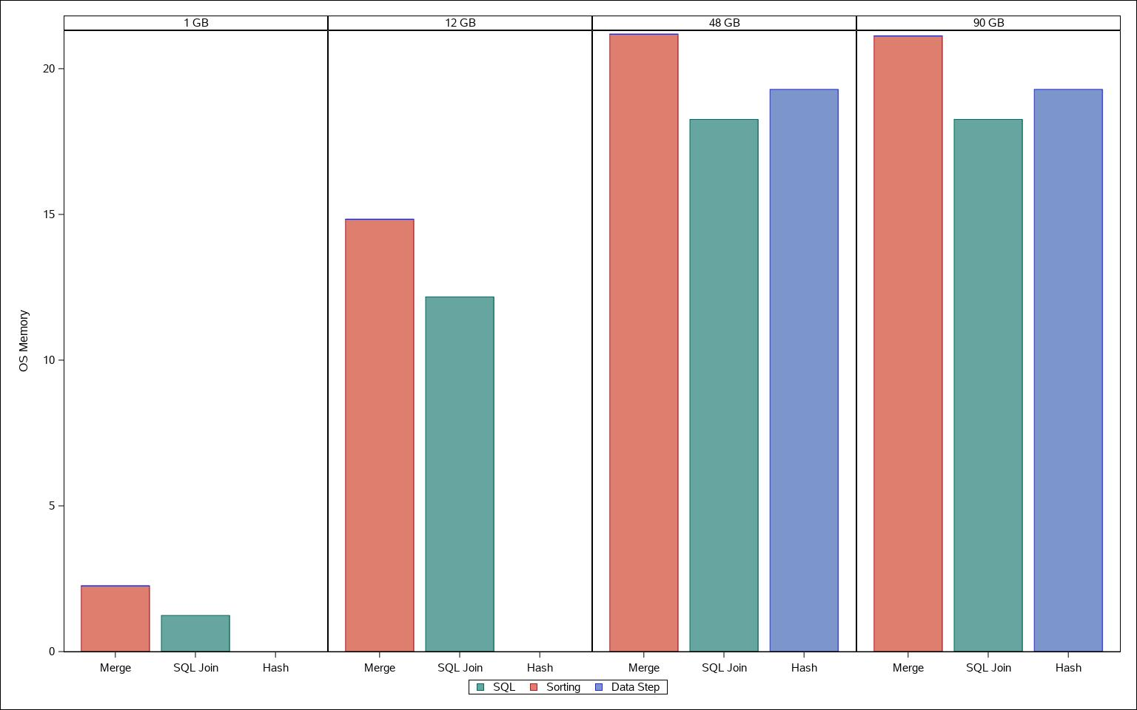
Speaker Bio → Introduction → Efficiency Overview → Methods Overview → Graphical Results → Conclusions

Slide 17
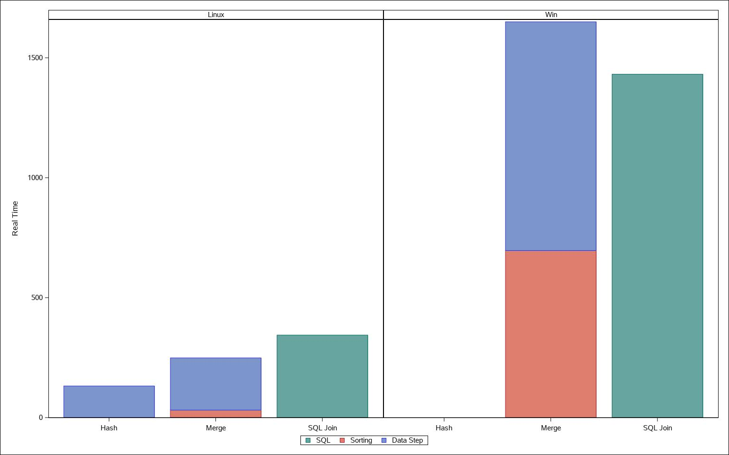
Speaker Bio → Introduction → Efficiency Overview → Methods Overview → Graphical Results → Conclusions
MEMSIZE = 24 GB
What happened here?

Slide 18
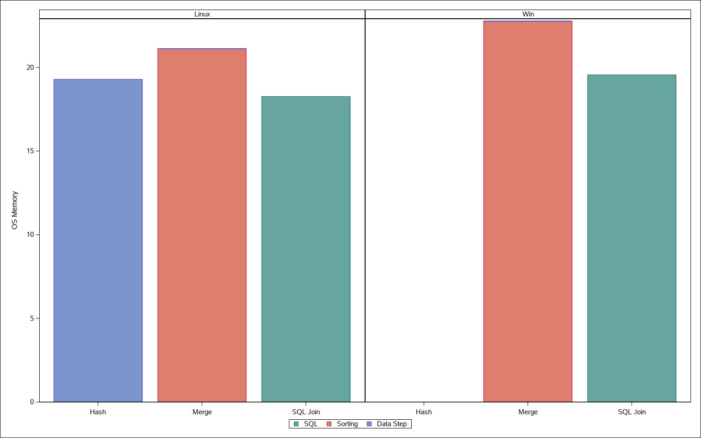
Speaker Bio → Introduction → Efficiency Overview → Methods Overview → Graphical Results → Conclusions

Slide 19
Conclusions
Speaker Bio → Introduction → Efficiency Overview → Methods Overview → Graphical Results → Conclusions
Join type & size (2, 4, or 8M records) → No change in patterns
Join Method
PROC SQL → More time without saving memory
DATA Step
With hash objects → higher RAM, lower real time & moderate CPU time
Without hash objects → Least RAM, least CPU & moderate Real time
OS → Linux > Windows!?
Mitigating factors: Multithreading, I/O, & Windows memory settings

Slide 20
Thank you!
Speaker Bio → Introduction → Efficiency Overview → Methods Overview → Graphical Results → Conclusions
Jonathan W. Duggins
North Carolina State University
https://duggins.wordpress.ncsu.edu/

