Slide 1
HOW-113 Exploring Sampling Distributions with SAS Studio: An Activity for Statistics Educators
Jonathan W. Duggins; James Blum
NC State University; UNC Wilmington

Slide 2
Agenda
Introduction
SAS Studio Basics
Tasks
Snippets
Editing Code
Summary

Slide 3
Introduction
Motivation
Guidelines for Assessment and Instruction in Statistics Education (GAISE)
Scenario
National Center for Missing and Exploited Children (NCMEC) Data
Explore data → New techniques?

Slide 4
Introduction: SAS Studio
What is SAS Studio®?
What is SAS University Edition®?
Session Goals?
Read data from external source
Explore data graphically (Tasks)
Create numerical summaries of data (Tasks)
Select random samples (Tasks)
Generate sampling distributions (Snippets)

Slide 5
SAS Studio Basics
Navigation
Work Area
Visual Programmer?

Slide 6
Example Data
National Center for Missing and Exploited Children (NCMEC)
March, 2017
19 variables on 2818 cases
Sex, Race, Hair Color, etc.
Age, Height, Weight, etc.
Date of Birth, Date Missing, etc.

Slide 7
Activity Goal
Create a histogram of the population
Take an SRS from the population
Calculate a sample statistic
Mean AGE
Generate a sampling distribution
Create a histogram of the sampling distribution

Slide 8
Accessing Data

Slide 9
Tasks
Point-and-click
Menu-driven interface
Generate code
SAS- or User-created
Tasks split into categories
Data, Graph, Statistics, etc.

Slide 10
Histogram Task Node
Red triangle indicates input needed
Control Ports
Left & Right
Used to sequence nodes

Slide 11
Histogram Task Menu

Slide 12
Histogram Available Tabs
Settings
Data: Select, filter, variables
Options: Titles, footnotes, etc.
Information: Help resources
Node: Metadata
Code/Results
Code
Log
Results

Slide 13
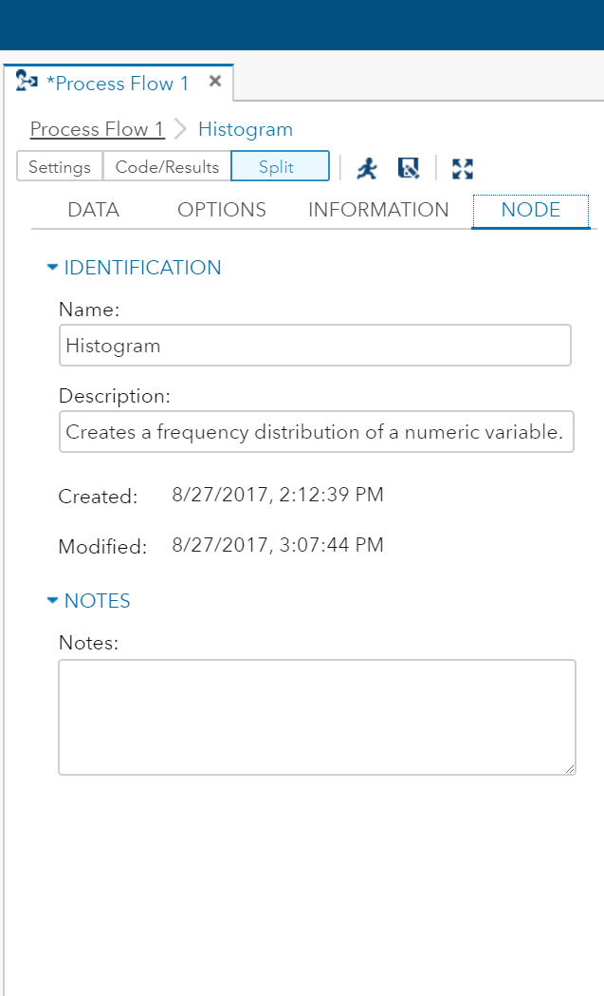
Histogram Info and Node
Change this to name your task!

Slide 14
Results Tab

Slide 15
Next up: Sampling!
Drag the next task over
Connect the control ports

Slide 16
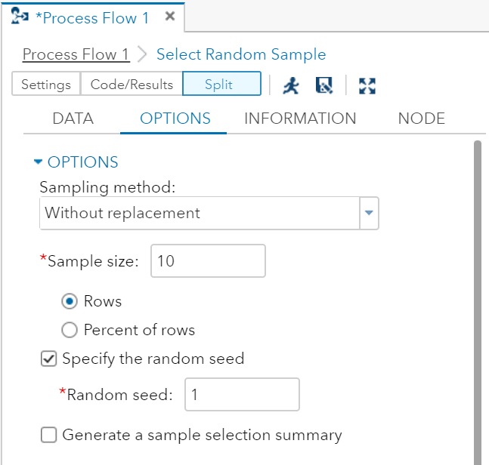
Random Sample Node
Leave as 1 for today

Slide 17
Random Sample Output
New tab
Output Data
Depends on SEED=

Slide 18
Next Step: Investigate
Histogram of Sample
Reinforce variability
GAISE Levels B & C

Slide 19
Histogram of Sample

Slide 20
Calculating Statistics
Summary Statistics Task
Calculate variety of basic statistics
Display and/or store them in data set

Slide 21
Summary Stats: Data Tab
Select:
Data set
Summary variables
Class variables
None yet
GAISE Level B

Slide 22
Summary Stats: Options
Select:
Statistics
Basic
Additional
Percentiles
Plots
Prefer histogram task
Details
DF for variance

Slide 23
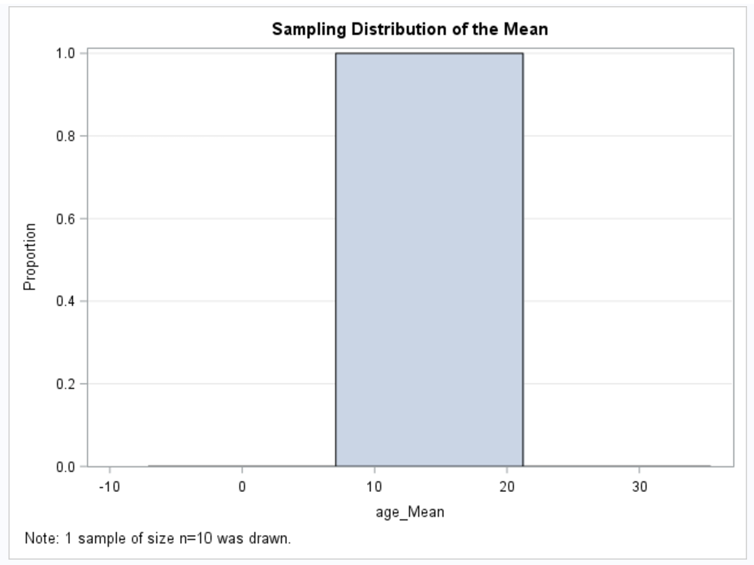
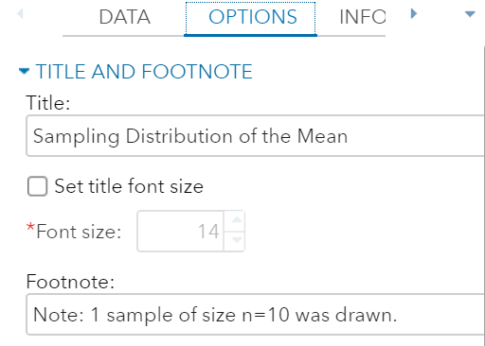
Another Histogram Node
Motivate discussion about samples vs. sampling distributions
No density curves!

Slide 24
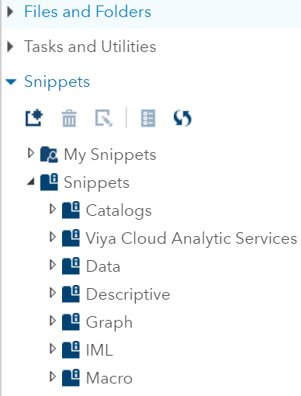
Snippets
Prepared code segments
~50 across 7 categories
Custom snippets possible
Editable
Edit provided code
Edited code can become new snippet

Slide 25
Custom Snippet
Recall, tasks generate code
E.g. Select Random Sample Task
Code not editable & no task setting for multiple samples
But PROC SURVEYSELECT can do it!

Slide 26
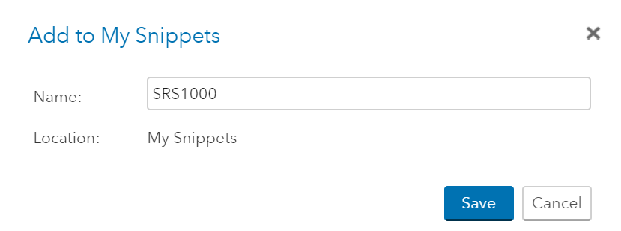
Accessing Task Code
Edit icon copies code into new tab
Here code can be modified: REPS = 1000
Add to My Snippets

Slide 27
Adding the Snippet
Snippets → My Snippets → SRS1000
Drag over & connect just like a task
Submit
Double-click and select running person icon
Right-click and select Run

Slide 28
Results from the Snippet

Slide 29
Final Process Flow
Added two new tasks
Summary Statistics
Calculate 1000 means
Histogram
Graph the sampling distribution

Slide 30
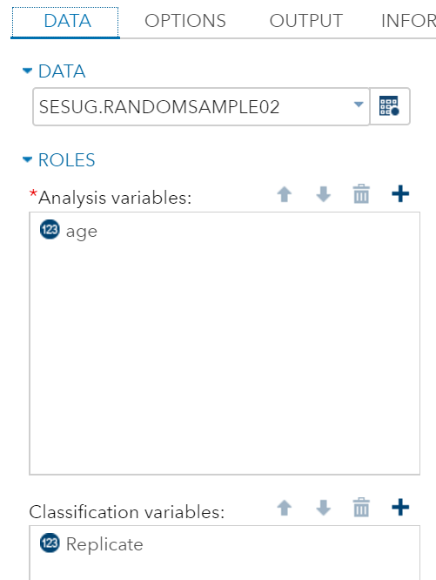
Summarizing By Replicate
Select
new random sample
analysis variable
Class variable
Separate statistics by replicate
Not GAISE Level B

Slide 31
Results by Replicate
Depends on SEED=
14.14 for group 1
Same as SUMM01 node
Make sure to save to a data set!

Slide 32
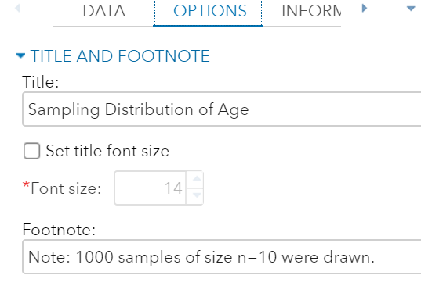
The Final Histogram

Slide 33
Histogram of Sample

Slide 34
Customizing the Code
Simplifying output
SEED=
Sampling distribution of other statistics
Mean, median, standard deviation, etc.
Sample size
5, 10, 20, etc.

Slide 35
Process Flow → Code
Sends code to new program window
Order of control port connections!

Slide 36
Suppressing Output
Code was automatically generated
Summary Statistic node uses PROC MEANS
Default is to print output
Add NOPRINT option
Noticeable change in SUMM02 node
1000 means printed → no means printed
Still saved to data set

Slide 37
Changing Sample Size
Macro variables available across program
Define sample size once at top of program
Use same value in all locations
Reference with &n

Slide 38
More Changes
Can be referenced in titles & footnotes
Similar changes could be used to
Set the SEED= value
SEED>0 → fixed; SEED ≤ 0 → based on clock
Select the statistic
%LET stat=mean

Slide 39
Histogram with n=20

Slide 40
SAS Studio & GAISE: A Summary
Powerful tool for classroom use
Provides natural scaffolding
Tasks are menu-driven & code is generated
As student comfort increases:
Less teacher involvement in tasks →More focus on code
Allows for quick access to graphics as necessary for all GAISE levels
Industry-standard data management and analysis software

