Slide 1
SESUG 236-2018 Web Scraping in SAS: A Macro-Based Approach
Jonathan W. Duggins; James Blum
NC State University; UNC Wilmington

Slide 2
Presenter
Name
Title, Company
[Insert your presenter bio here.]
Example: John Smith is a business analyst at ABC Company where he has been since 1993. John uses SAS® in his daily responsibilities of quality management. He has used SAS for more than 10 years.

Slide 3
Agenda
Introduction
Data Source
Single-Page Scraping
Multi-Page Scraping
Conclusion

Slide 4
Introduction
Motivation
Common request from students and academic consulting clients
Scenario
Popular web comic, xkcd.com, chosen as case study

Slide 5
Data Source: Planning Ahead
Robots.txt
Where is the data?
Stored directly in a file?
Embedded in HTML code on a single page
Embedded in HTML code across multiple pages

Slide 6
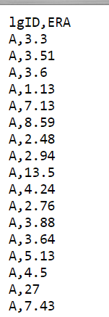
Data Source: Direct File Access
Connect to website
FILENAME era URL "https://www4.stat.ncsu.edu/~duggins/SESUG2018/ERA.txt";
DATA era;
INFILE era DSD FIRSTOBS = 2;
INPUT MaskedLeague : $1. ERA;
RUN;
Read as with any other fileref

Slide 7
Single-Page Scraping
Direct access not very common
Embedded HTML code → parsing
Access source code
Identify tags, line numbers, etc.
Separate HTML code from data
Two main approaches: DATA step vs. SQL

Slide 8
Single-Page: Access Source Code
Temporarily store source code in logical memory
PROC HTTP!
FILENAME source TEMP;
PROC HTTP
URL = "https://xkcd.com/archive/"
OUT = source
METHOD = "GET";
RUN;
Web address
Fileref
Request sent to URL

Slide 9
Single-Page: Identify Data
<head>
<link rel="stylesheet" type="text/css" href="/s/b0dcca.css" title="Default"/>
<title>xkcd - A webcomic of romance, sarcasm, math, and language - By Randall Munroe</title>
<meta http-equiv="X-UA-Compatible" content="IE=edge"/>
<link rel="shortcut icon" href="/s/919f27.ico" type="image/x-icon"/>
<link rel="icon" href="/s/919f27.ico" type="image/x-icon"/>
<link rel="alternate" type="application/atom+xml" title="Atom 1.0" href="/atom.xml"/>
<link rel="alternate" type="application/rss+xml" title="RSS 2.0" href="/rss.xml"/>
<script type="text/javascript" src="/s/b66ed7.js" async></script>
<script type="text/javascript" src="/s/1b9456.js" async></script>
</head>
<h1>Comics:</h1><br/>
(Hover mouse over title to view publication date)<br /><br />
<a href="/2050/" title="2018-9-24">6/6 Time</a><br/>
<a href="/2049/" title="2018-9-21">Unfulfilling Toys</a><br/>
~8000 lines total
~25% contain data I want to scrape
Data I want is in these lines

Slide 10
Single-Page: Parsing Source Code
<a href="/2050/" title="2018-9-24">6/6 Time</a><br/>
DATA work.xkcdArchive(DROP = line);
INFILE source LENGTH = recLen LRECL = 32767;
INPUT line $VARYING32767. recLen;
RUN;
Read in source code from temporary fileref
LENGTH= required for $VARYING informat

Slide 11
Single-Page: Parsing Source Code
<a href="/2050/" title="2018-9-24">6/6 Time</a><br/>
DATA work.xkcdArchive(DROP = line);
INFILE source LENGTH = recLen LRECL = 32767;
INPUT line $VARYING32767. recLen;
FORMAT num 4. date DATE9.;
LENGTH title $ 50;
RUN;
Data I’m parsing includes: Comic number, Date published, and Comic Title

Slide 12
Single-Page: Parsing Source Code
<a href="/2050/" title="2018-9-24">6/6 Time</a><br/>
DATA work.xkcdArchive(DROP = line);
INFILE source LENGTH = recLen LRECL = 32767;
INPUT line $VARYING32767. recLen;
FORMAT num 4. date DATE9.;
LENGTH title $ 50;
IF FIND(line, '<a href=') GT 0 AND FIND(line, 'title=') GT 0
RUN;
Identify lines like those shown above:
Anchor tags with HREF= and TITLE= sufficient here

Slide 13
Single-Page: Parsing Source Code
<a href="/2050/" title="2018-9-24">6/6 Time</a><br/>
DATA work.xkcdArchive(DROP = line);
INFILE source LENGTH = recLen LRECL = 32767;
INPUT line $VARYING32767. recLen;
FORMAT num 4. date DATE9.;
LENGTH title $ 50;
IF FIND(line, '<a href=') GT 0 AND FIND(line, 'title=') GT 0
THEN DO;
num = INPUT(scan(strip(line),2,'/'),4.);
date = INPUT(scan(strip(line),4,'"'),YYMMDD10.);
title = SCAN(strip(line),2,'<>');
OUTPUT;
END;
RUN;
Extract data

Slide 14
Single-Page: Results

Slide 15
Multi-Page Scraping
Necessitated by large and/or changing data
Must determine how pages are defined
Including URL Parameters
www.example.com/?page=2 or www.example.com/?Year=2012&?Month=5
Updating Web Server Path
www.example.com/page2 or www.example.com/2012/5
Macro for looping

Slide 16
Multi-Page Scraping: Macro Variables
xkcd.com uses web server path based on comic number
PROC SQL NOPRINT;
SELECT DISTINCT num, count(DISTINCT num)
INTO :indexList separated BY ' ', :indexCount
FROM work.xkcdArchive
;
QUIT;
Get list and count of comic numbers
Save as macro variables
Previously scraped single page

Slide 17
Multi-Page Scraping: Macro Setup
%macro Scrape(start=1, stop=&indexCount, out=, append=, sleep=5);
%if %sysfunc(compress(%upcase(%substr(&append,1,1)))) = N %then %do;
proc datasets library = work nolist;
delete all;
run;
quit;
%end;
%else %put QC_ERROR: Append status must be Yes or No. &=append;
%do i = &start %to &stop;
%let index = %scan(&indexList, &i);
filename source temp;
proc http
url="https://xkcd.com/&index/"
out=source
method="GET";
run;
data work.xkcdRawTemp;
infile source length=len lrecl=32767;
input line $varying32767. len;
LineNum = _n_;
run;
Appending?
Begin loop
Access source for a single page

Slide 18
Multi-Page Scraping: SQL
proc sql noprint;
create table work.xkcdParsedTemp as
select &index as comicNum, a.*, b.*, c.*, d.*, e.*
from (select htmldecode(scan(line,2,'<>')) as title
from work.xkcdRawTemp
where line contains 'div id="ctitle"') as a,
(select distinct htmldecode(scan(line,4,'"')) as Hover, htmldecode(scan(line,6,'"')) as AltHover
from work.xkcdRawTemp
where line contains '<img src=' and line contains 'title') as b,
(select htmldecode(strip(scan(line,6,' <'))) as PermLink
from work.xkcdRawTemp
where line contains 'Permanent link to this comic:') as c,
(select htmldecode(strip(scan(line,5,' '))) as EmbedLink
from work.xkcdRawTemp
where line contains 'Image URL (for hotlinking/embedding)') as d,
(select LineNum, htmldecode(line) as test
from work.xkcdrawTemp
where (LineNum ge (select min(LineNum)
from work.xkcdRawTemp
where line contains '<div id="transcript"')
and LineNum le (select min(LineNum)
from work.xkcdRawTemp
where line contains '</div>'
and LineNum ge (select min(LineNum)
from work.xkcdRawTemp
where line contains '<div id="transcript"')))) as e;
quit;
Subqueries and inline views used to build records

Slide 19
Multi-Page Scraping: Data Cleaning
data work.xkcdClean;
set work.xkcdParsedTemp;
if find(test,'[[') gt 0 then do;
startsq = find(test,'[[')+2;
test = strip(compress(substr(test,startsq),'[]'));
end;
if find(test,'{{') gt 0 or find(upcase(test), 'ALT TEXT') gt 0 then do;
startcu = find(test,'{{')+1;
test = strip(compress(substr(test,startcu),'{}'));
end;
if find(test,'<div') gt 0 then test = strip(scan(test,2,'>'));
test = strip(tranwrd(tranwrd(tranwrd(tranwrd(test,']]',''),'}}',''),'</div>',''),'</div',''));
run;
proc append base = work.all data = work.xkcdClean;
run;
data _null_;
call sleep(&sleep,1);
run;
%end;
proc transpose data = work.all out = work.&out (drop = _name_) prefix = Line;
by comicnum title hover altHover permLink EmbedLink;
id linenum;
var test;
run;
%mend;
Data cleaning
Append and wait
Rotate

Slide 20
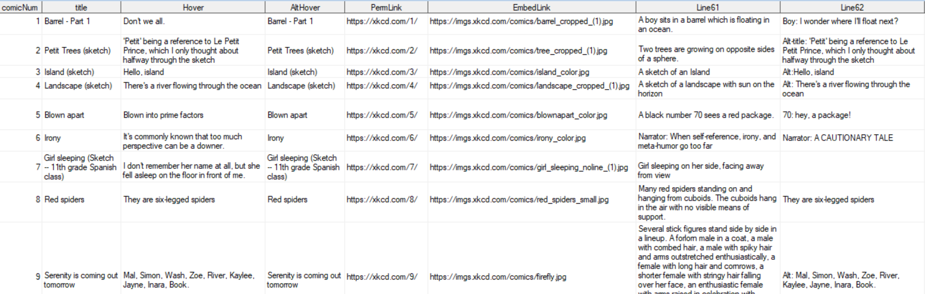
Single-Page: Results

Slide 21
Conclusion
Beware potential pitfalls
Inconsistent HTML code, website updates
Efficiency
DATA step vs SQL
Versatility of PROC HTTP

